Slide 1
Introduction to Data Storage
at Research Computing
Gerardo Hidalgo-Cuellar
Email: ghidalgo93@gmail.com
Slides: https://github.com/ghidalgo93/RCTutorial
Notes:
Hello my name is Gerardo, welcome...
Today, were going to talk about the ideas and motivations behind storage in high performance computing, the storage systems that users of CU Research Computing have access to, and some of the use cases for these systems.
As a brief aside, my presentation will be aimed toward...
Grad student that use a PC every day
Aware of high level HPC concepts (lots of computational power, ie supercomputer)
May not be familiar with the linux filesystem (though may know basics of storage)

Slide 2
Key Takeaways
Why High Performance Computing (HPC) has specific storage needs
What storage systems users have access to at CU Research Computing (RC)
What each storage system should or shouldn’t be used for
HPC Storage | RC Storage | Wrap up & Questions
Notes:
To begin, I want to layout exactly want you all to walk away with at the end of this presentation…

Slide 3
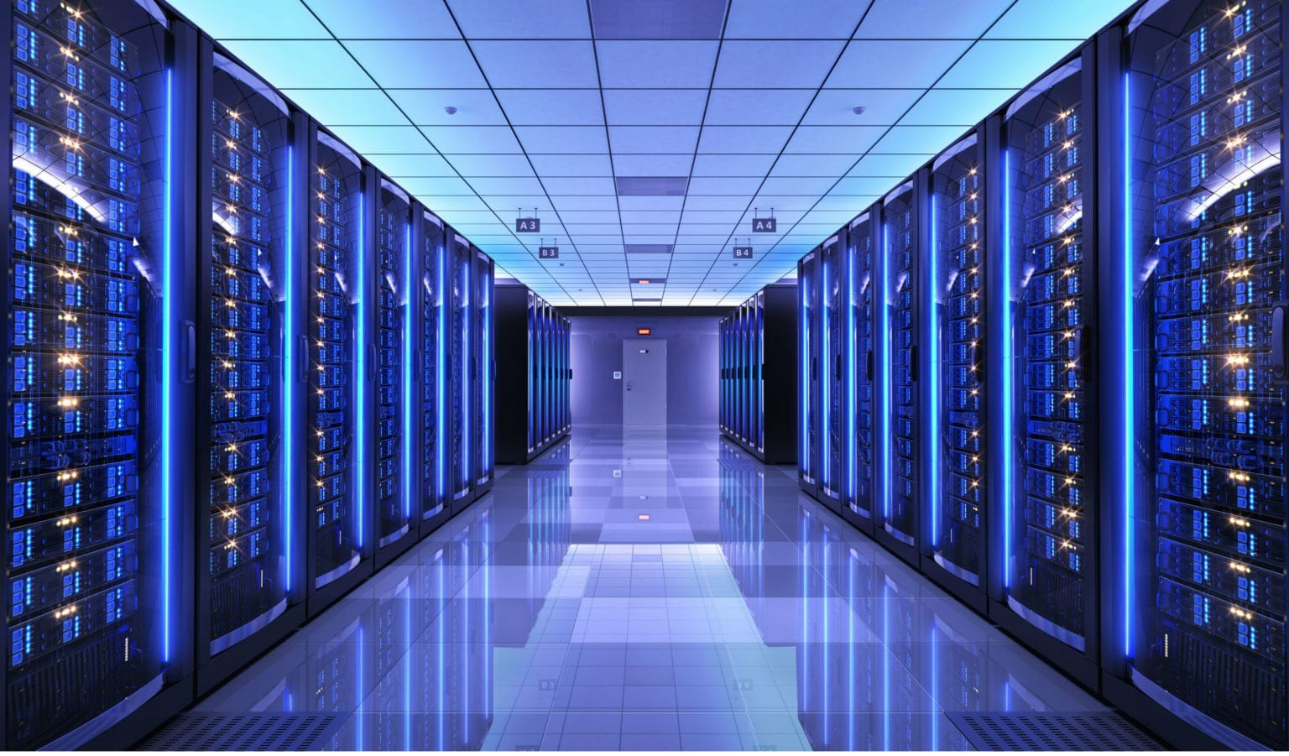

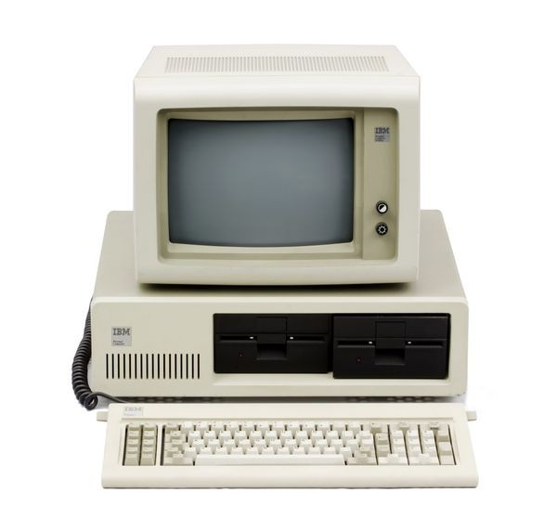
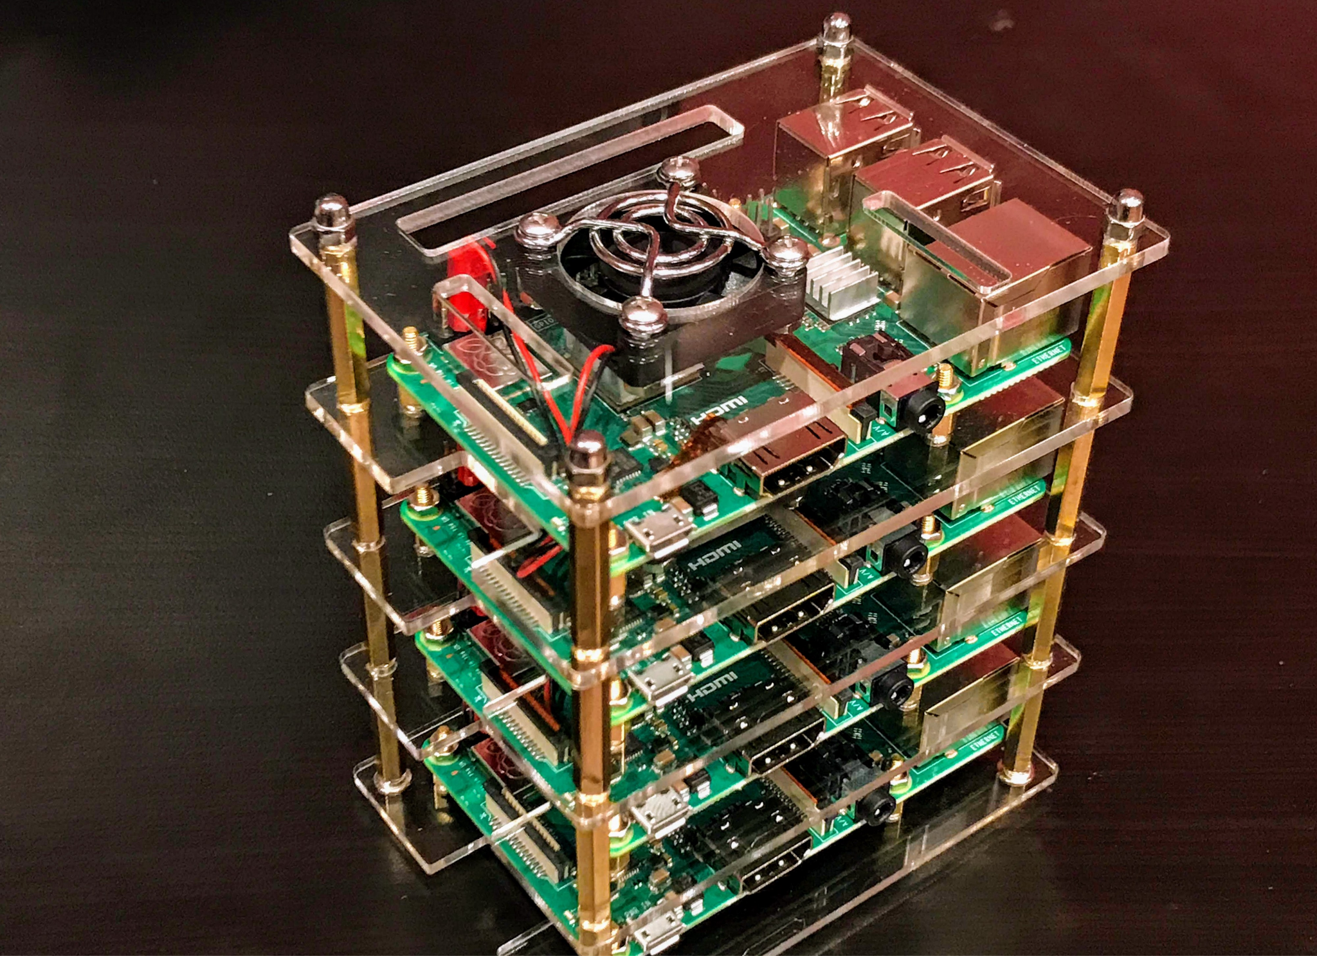

High Performance Computing
HPC
Personal Computers
Personal Data
Photos
Games
Applications...
Quantum mechanics
Weather forecasting
Molecular sciences
Early universe...
HPC Storage | RC Storage | Wrap up & Questions
Notes:
When comparing the storage needs of PCs and HPC systems, it may be useful to think about the kind of data they will be storing/transferring…
“...combining computing power in a way that delivers higher performance than one could get out of a typical...computer” -USGS
For example RC system or other supercomputers, or even a cluster of rpis - individually less powerful but together more so
When talking about HPC systems (things come to mind LOTS OF DATA, LOTS OF COMPUTATIONAL POWER) some of the immediate demands then:
Data to be read/written could be a thousand million times more than what you could expect on a PC (https://www.weka.io/learn/hpc-storage-explained/)
Shared resources
Hardware
individuals and groups, resources need to be kept available for all
Take advantage of high performance technology
Often high performance parallel file storage and high speed networking.
Because HPC is used to analyze massive amounts of data - users and administrators need to think carefully about how that data is stored, backed up, and transferred

Slide 4

High Performance Computing
Computer
Hardware
Submit Job
Management
service
Get Results
Storage
HPC Storage | RC Storage | Wrap up & Questions
Notes:
Looking at a HPC system from a top-down view
User submits a job to the management services
The manager will run the workload on the distributed resources (cpu, gpu, storage) connected by a network
Get the results back
Much faster than could normally be done
All parts are essential in the full system
But today we’re going to zoom into the storage aspects of HPC, as a researcher you may be most interested in your actual data - were is it? How is it stored? Is it backed up?
look specifically the storage systems users of RC computing will have access to.

Slide 5


Research Computing Storage
/home - user space
/projects - shared space
Local storage - e.g. your computer
PetaLibrary - storage for a fee
Scratch Space - temporary
Storage
HPC Storage | RC Storage | Wrap up & Questions
Notes:
RC users will gain access to (or the option to access) the following storage systems.
Each storage system has its own intentions and limitations, and also their own physical locations within/outside the network

Slide 6

Example Case:
Melisa wants to use RC resources to model early universe conditions
We’re going to follow her journey via the RC storage system
Has an RC account and has successfully accessed the network via the login node
/home/<user>
Login Node
/projects/<user>
Scratch space
HPC Storage | RC Storage | Wrap up & Questions

Slide 7
/home
/home/<user>
Login Node
Examples:
Slurm job script she’s been working on
Editor configurations
HPC Storage | RC Storage | Wrap up & Questions
Notes:
Low performance compared to others we will see

Slide 8
/home
/home/<user>
User Space
Low storage - 2gb
Visible from all nodes
Regularly backed up
Login Node
For | Not for
Source code Small compiled programs Job scripts | Intensive data read/write Sharing contents
HPC Storage | RC Storage | Wrap up & Questions
Notes:
Low performance compared to others we will see

Slide 9
/projects
Login Node
/projects/<user>
Examples:
Small dataset of test positions
Shared job scripts to be run
HPC Storage | RC Storage | Wrap up & Questions
Notes:
Low performance compared to others we will see

Slide 10
/projects
Shared space
Medium storage - 250gb
Visible from all nodes
Regularly backed up
Login Node
/projects/<user>
For | Not for
Store software builds Small data sets Sharing contents | Intensive data read/write
HPC Storage | RC Storage | Wrap up & Questions
Notes:
Low performance compared to others we will see

Slide 11
Scratch Space
Login Node
Scratch space
Examples:
Where her data will be written to throughout the job
Summit: /scratch/summit/<user>
Blanca: /rc_scratch/<user>
HPC Storage | RC Storage | Wrap up & Questions
Notes:
is a fast, parallel file system ideal for storing job input and output files

Slide 12
Scratch Space
Temporary
High storage - 10tb
NOT backed up
Purged when needed (max 90 days)
Login Node
Scratch space
For | Not for
Intensive data read/write on compute nodes | Long-term storage
HPC Storage | RC Storage | Wrap up & Questions
Notes:
is a fast, parallel file system ideal for storing job input and output files
dedicated for storage of temporary data. It is unreliable by intention and has no back up.

Slide 13
Long Term Storage
???
Data to analyze
HPC Storage | RC Storage | Wrap up & Questions

Slide 14




Long Term Storage
Local Storage
PetaLibrary
Your computer, hard drive, cloud storage, etc.
High capacity storage for a fee
NSF subsidized service
Backed up & Non-Backed up services
HPC Storage | RC Storage | Wrap up & Questions
Notes:
NSF subsidized-service used to store, archive, and share research data
Provides a variety of both backed up and non-backed up storage
We have followed the workflow of an RC user and how their data is transferred and stored (from user configs, source code, to large data sets)

Slide 15
Some examples!
Job scripts
User configs
Small datasets
Source code
Intensive data writes
Store data long-term
/home - user space
/projects - shared space
Local storage
PetaLibrary - storage for a fee
Scratch Space - temporary
HPC Storage | RC Storage | Wrap up & Questions
Notes:
To solidify these concepts, were going to go over some examples of places you might store different data.

Slide 16
Wrap Up
Why HPC has specific storage needs
Lots of data read/write
Shared resources
High performance dependent
What storage systems RC users have access to
Permanent vs Temporary
Network vs External
What each storage system should or shouldn’t be used for
Different storage/data transfer needs
HPC Storage | RC Storage | Wrap up & Questions
Notes:
As we wrap up, were going to revisit the key takeaways we highlighted at the start.
I hope this has been an informative introduction to storage in RC at the university of colorado.

Slide 17
Thank you
Questions?
HPC Storage | RC Storage | Wrap up & Questions

Slide 18
Citations
Images | Content
Wikipedia commons vectorstock.com medium.com raspberrypi.org | https://www.colorado.edu/rc/resources https://curc.readthedocs.io/ https://researchcomputing.princeton.edu/support/knowledge-base/data-storage https://www.weka.io/learn/hpc-storage-explained/ https://searchstorage.techtarget.com/definition/parallel-file-system https://www.usgs.gov/core-science-systems/sas/arc Introduction to HPC: https://www.youtube.com/watch?v=bkLVuNfiCVs

Slide 19
Backup slides

Slide 20
High Performance Computing (HPC)
“...the practice of aggregating computing power in a way that delivers much higher performance than one could get out of a typical...computer” -USGS
Notes:
Some typical computational barriers:
Time – processing on local systems is too slow or not feasible
CPU Capacity -- Can only run one model at a time
Management of Computer Systems – Science Groups don’t want to purchase and manage local computer systems – they want to focus on science

Slide 21
HPC file systems (general)
Collaborative
Scalable
Data integrity and security
Available
Transfer
Notes:
Might take this out

Slide 22
Jargon/Definitions
Used | Definition
I/O | input/output, data transfer
<placeholder> | YOUR input
.file_name | A hidden directory
HPC | High Performance Computing

